Slide 1
CAPSTONE PROJECT: EcobikeRental
Lecturner:Ph.D Nguyễn Thị Thu Trang
Group 11:
Nguyễn Thành Long
Nguyễn Hải Long
Nguyễn Công Luật
UnLyan

Slide 2
Content
Interaction Diagram
Class Diagram
Design consideration

Slide 3
Assignment
Name |  | Work assignment
Nguyễn Thành Long | Leader | Use-case rent bike
Nguyễn Hải Long | Member | Use-case Station Info
Nguyễn Công Luật | Member | Use-case Bike Info
Un Lyan | Member | Use-case return bike

Slide 4
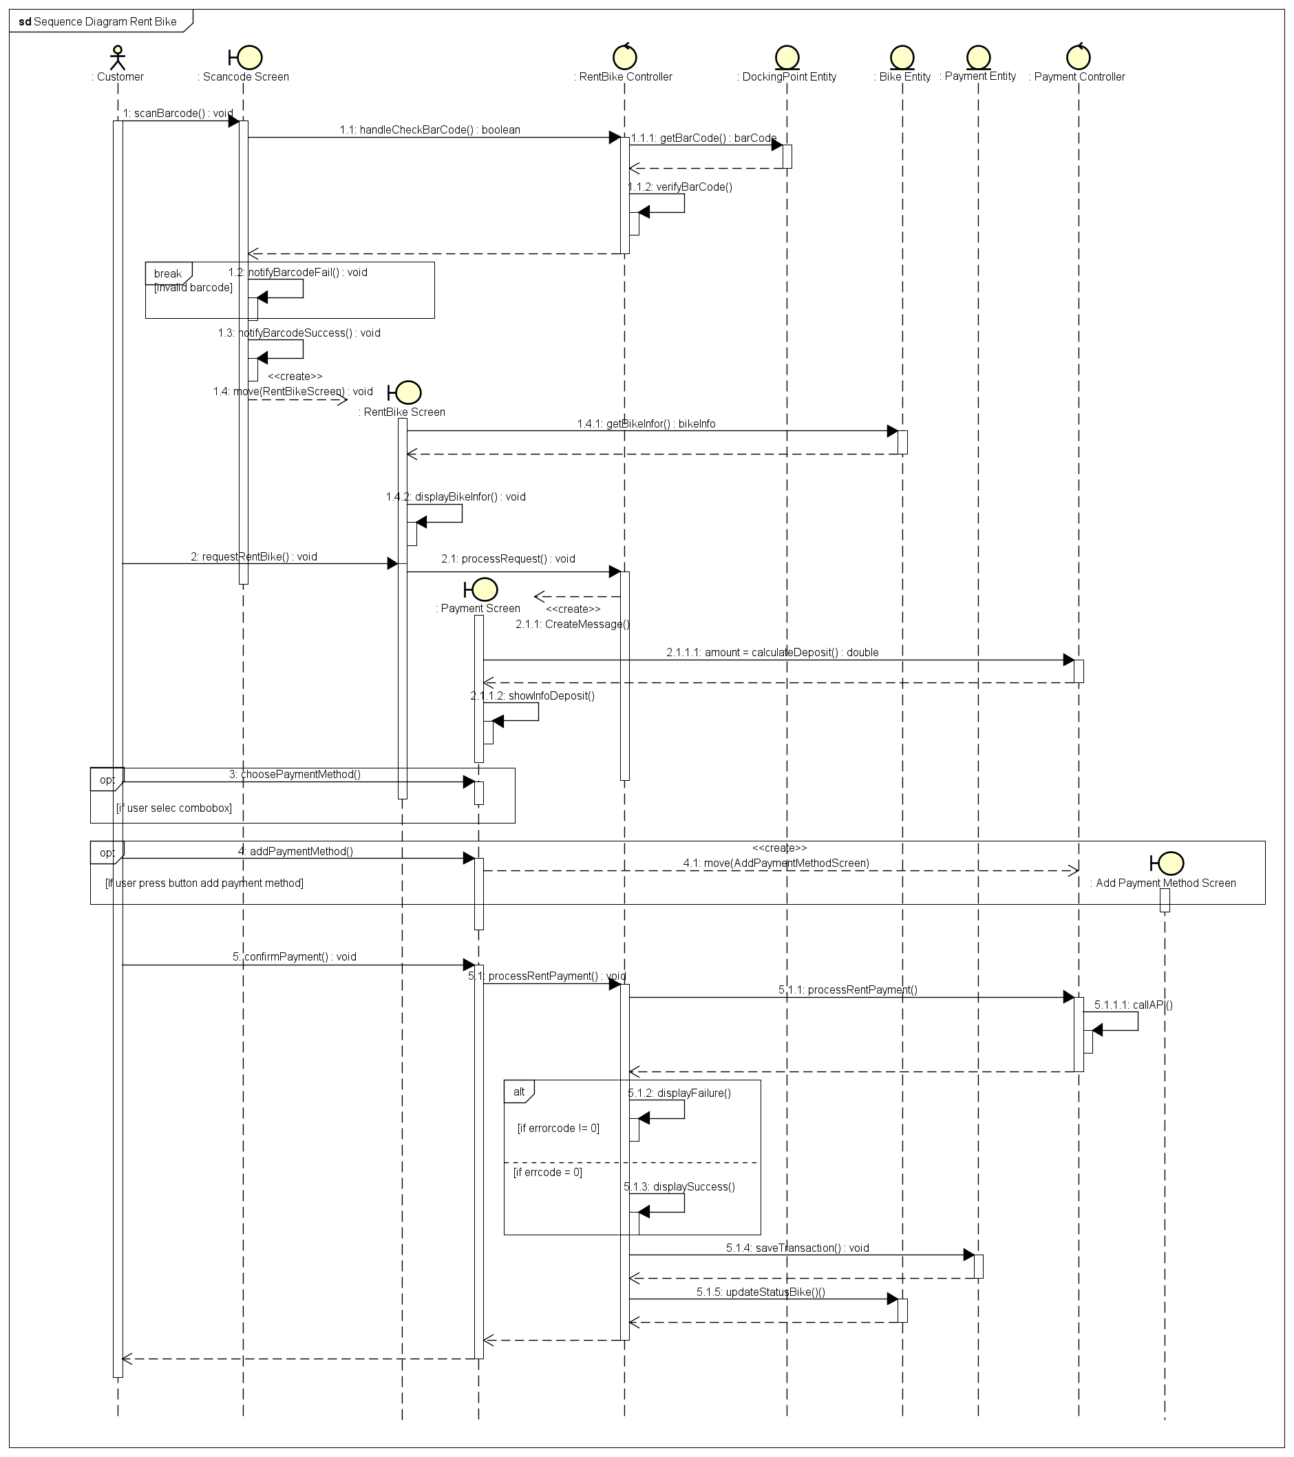
Interaction Diagram
Notes:
A common misconception is that the term Wi-Fi is short for "wireless fidelity," however this is not the case. "Wi-Fi" is not short for "Wireless Fidelity," but is simply a name chosen by the Wi-Fi Alliance.

Slide 5
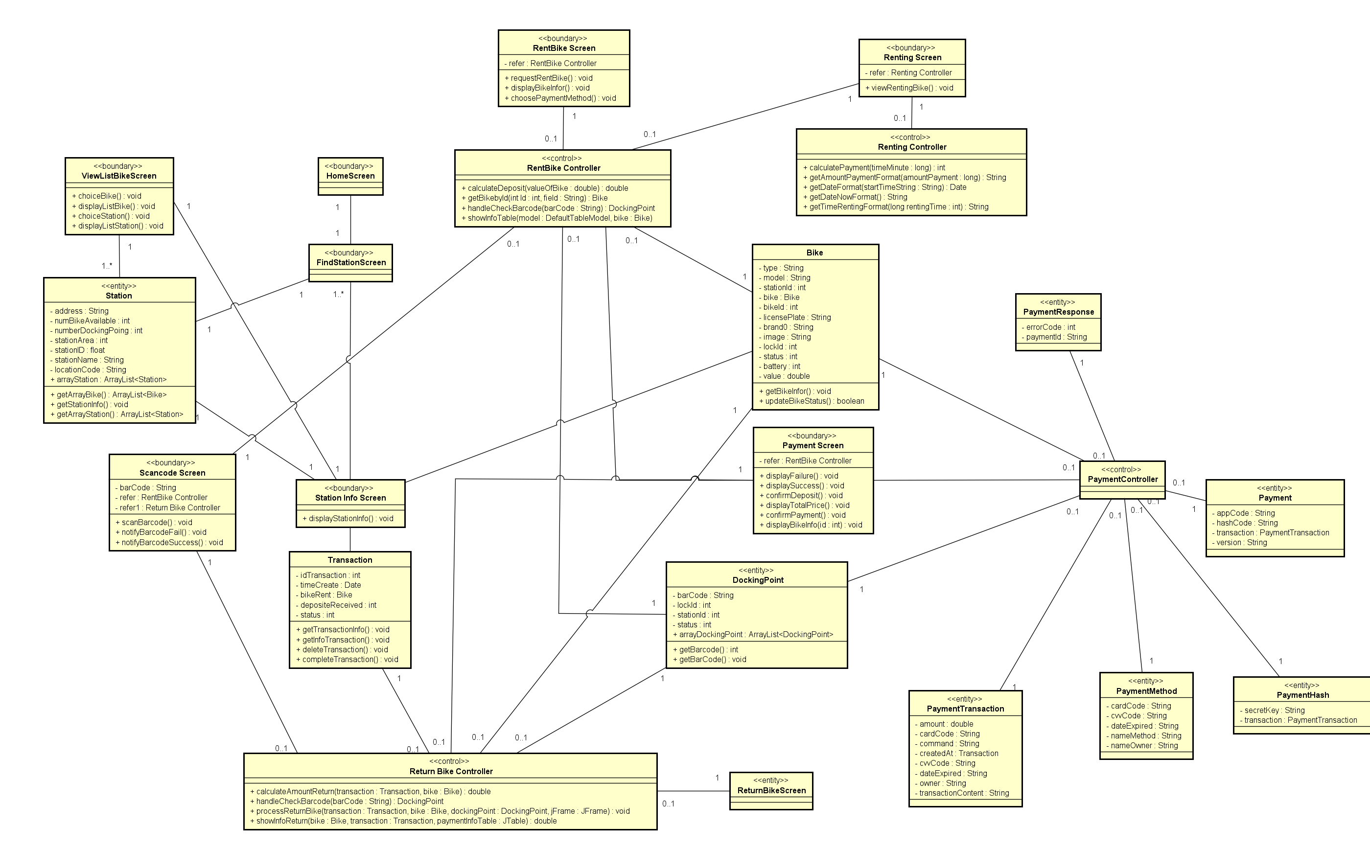
Class Diagram General

Slide 6
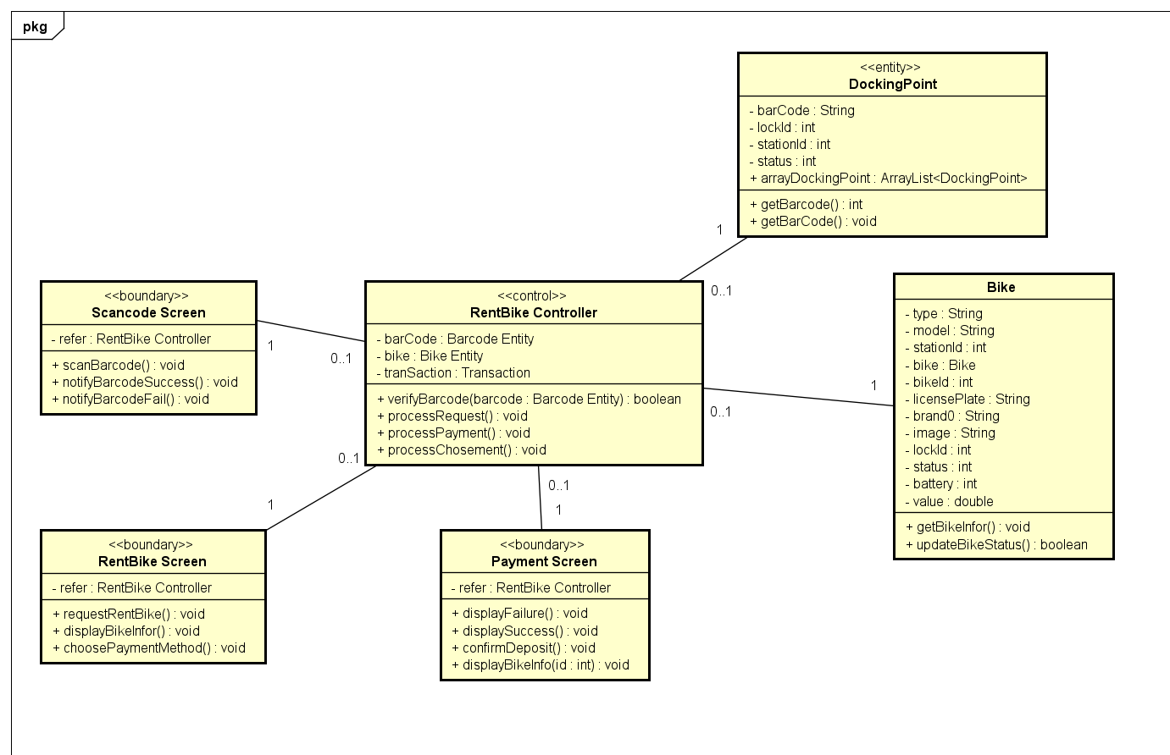
Class Diagram Details
Class diagram rentbike

Slide 7
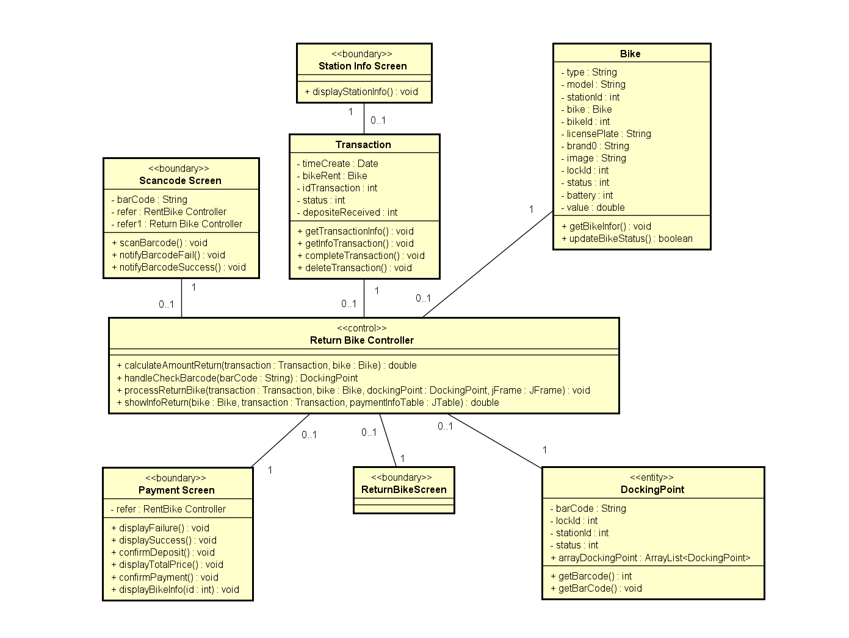
Class Diagram Details
Class diagram returnbike

Slide 8
Design Consideration
Goals:
Usability.
Performance.
Learnability.
Guidelines:
The source code is neat, clean.
The function's name must describe the reason of using function clearly and briefly.
Meaningfull and understandable variables name helps anyone to understand the reson of using it.

Slide 9
Design Consideration
Design:
Programming languge: Java.
Automatic manager and setup: Maven.
Interface: Java Swing.
Databse: MySQL
Future plan: expand more vehicles, has the function for the administrator side.

Slide 10
Design Principles
Apply according to SOLID principles
Single responsibility principle
Open/closed principle
Liskov substitution principle
Interface segregation principle
Dependency inversion principle

Slide 11

THANK YOU !!!

